Slide 1
COMBINATIONAL CIRCUITS
COMPUTER SYSTEM ARCHITECTURE
BY:
ROSHNI PATOA

Slide 2
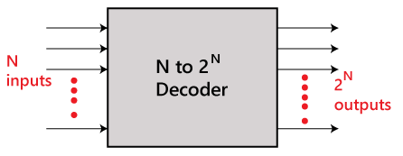
DECODER
The combinational circuit that change the binary information into 2^{N} output lines is known as Decoders. The binary information is passed in the form of N input lines. The output lines define the 2^{N}-bit code for the binary information. In simple words, the Decoder performs the reverse operation of the Encoder. At a time, only one input line is activated for simplicity. The produced 2^{N}-bit output code is equivalent to the binary information.

Slide 3
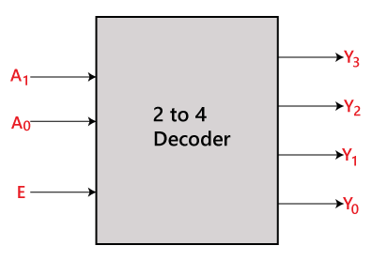
2X4 DEcoder
In 2x4 decoder, there is a total of three inputs, i.e., A0, and A1 and E and four outputs, i.e., Y0, Y1, Y2, and Y3. For each combination of inputs, when the enable 'E' is set to 1, one of these four outputs will be 1. The block diagram and the truth table of the 2 to 4 line decoder are given below.

Slide 4
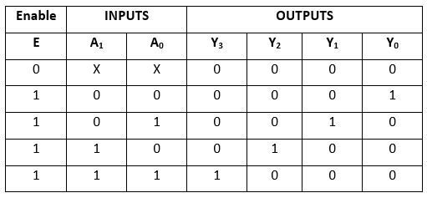
Truth Table for 2x4 decoder
The logical expression of the term Y0, Y0, Y2, and Y3 is as follows:
Y₃=E.A₁.A₀ Y₂=E.A₁.A₀' Y₁=E.A₁'.A₀ Y0=E.A₁'.A₀'

Slide 5
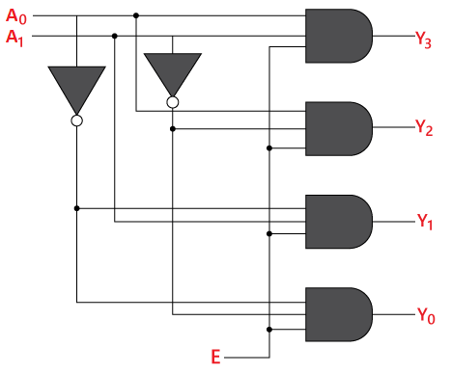
LOGIC DIAGRAM for 2x4 DEcoder

Slide 6
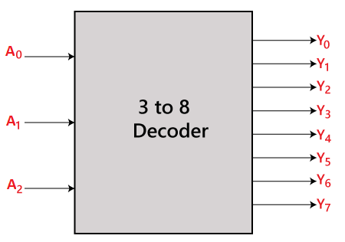
3X8 DECODER
The 3x8 decoder is also known as Binary to Octal Decoder. In a 3x8 decoder, there is a total of eight outputs, i.e., Y₀, Y₁, Y₂, Y₃, Y₄, Y₅, Y₆, and Y₇ and three outputs, i.e., A₀, A1, and A₂. This circuit has an enable input 'E'. Just like 2x4 line decoder, when enable 'E' is set to 1, one of these four outputs will be 1. The block diagram and the truth table of the 3x8 encoder are given below.

Slide 7
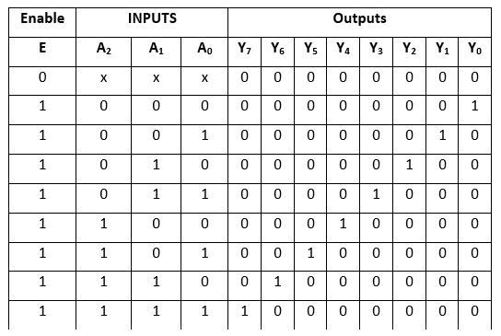
Truth Table for 3x8 DECODER
The logical expression of the term Y0, Y1, Y2, Y3, Y4, Y5, Y6, and Y7 are as follows:
Y0=A0'.A1'.A2' Y1=A0.A1'.A2' Y2=A0'.A1.A2' Y3=A0.A1.A2' Y4=A0'.A1'.A2 Y5=A0.A1'.A2 Y6=A0'.A1.A2 Y7=A0.A1.A2

Slide 8
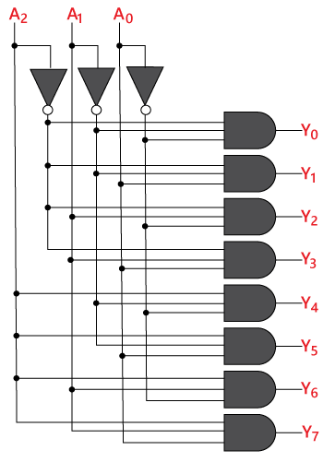
LOGIC DIAGRAM for 3x8 DECODER

